Slide 1
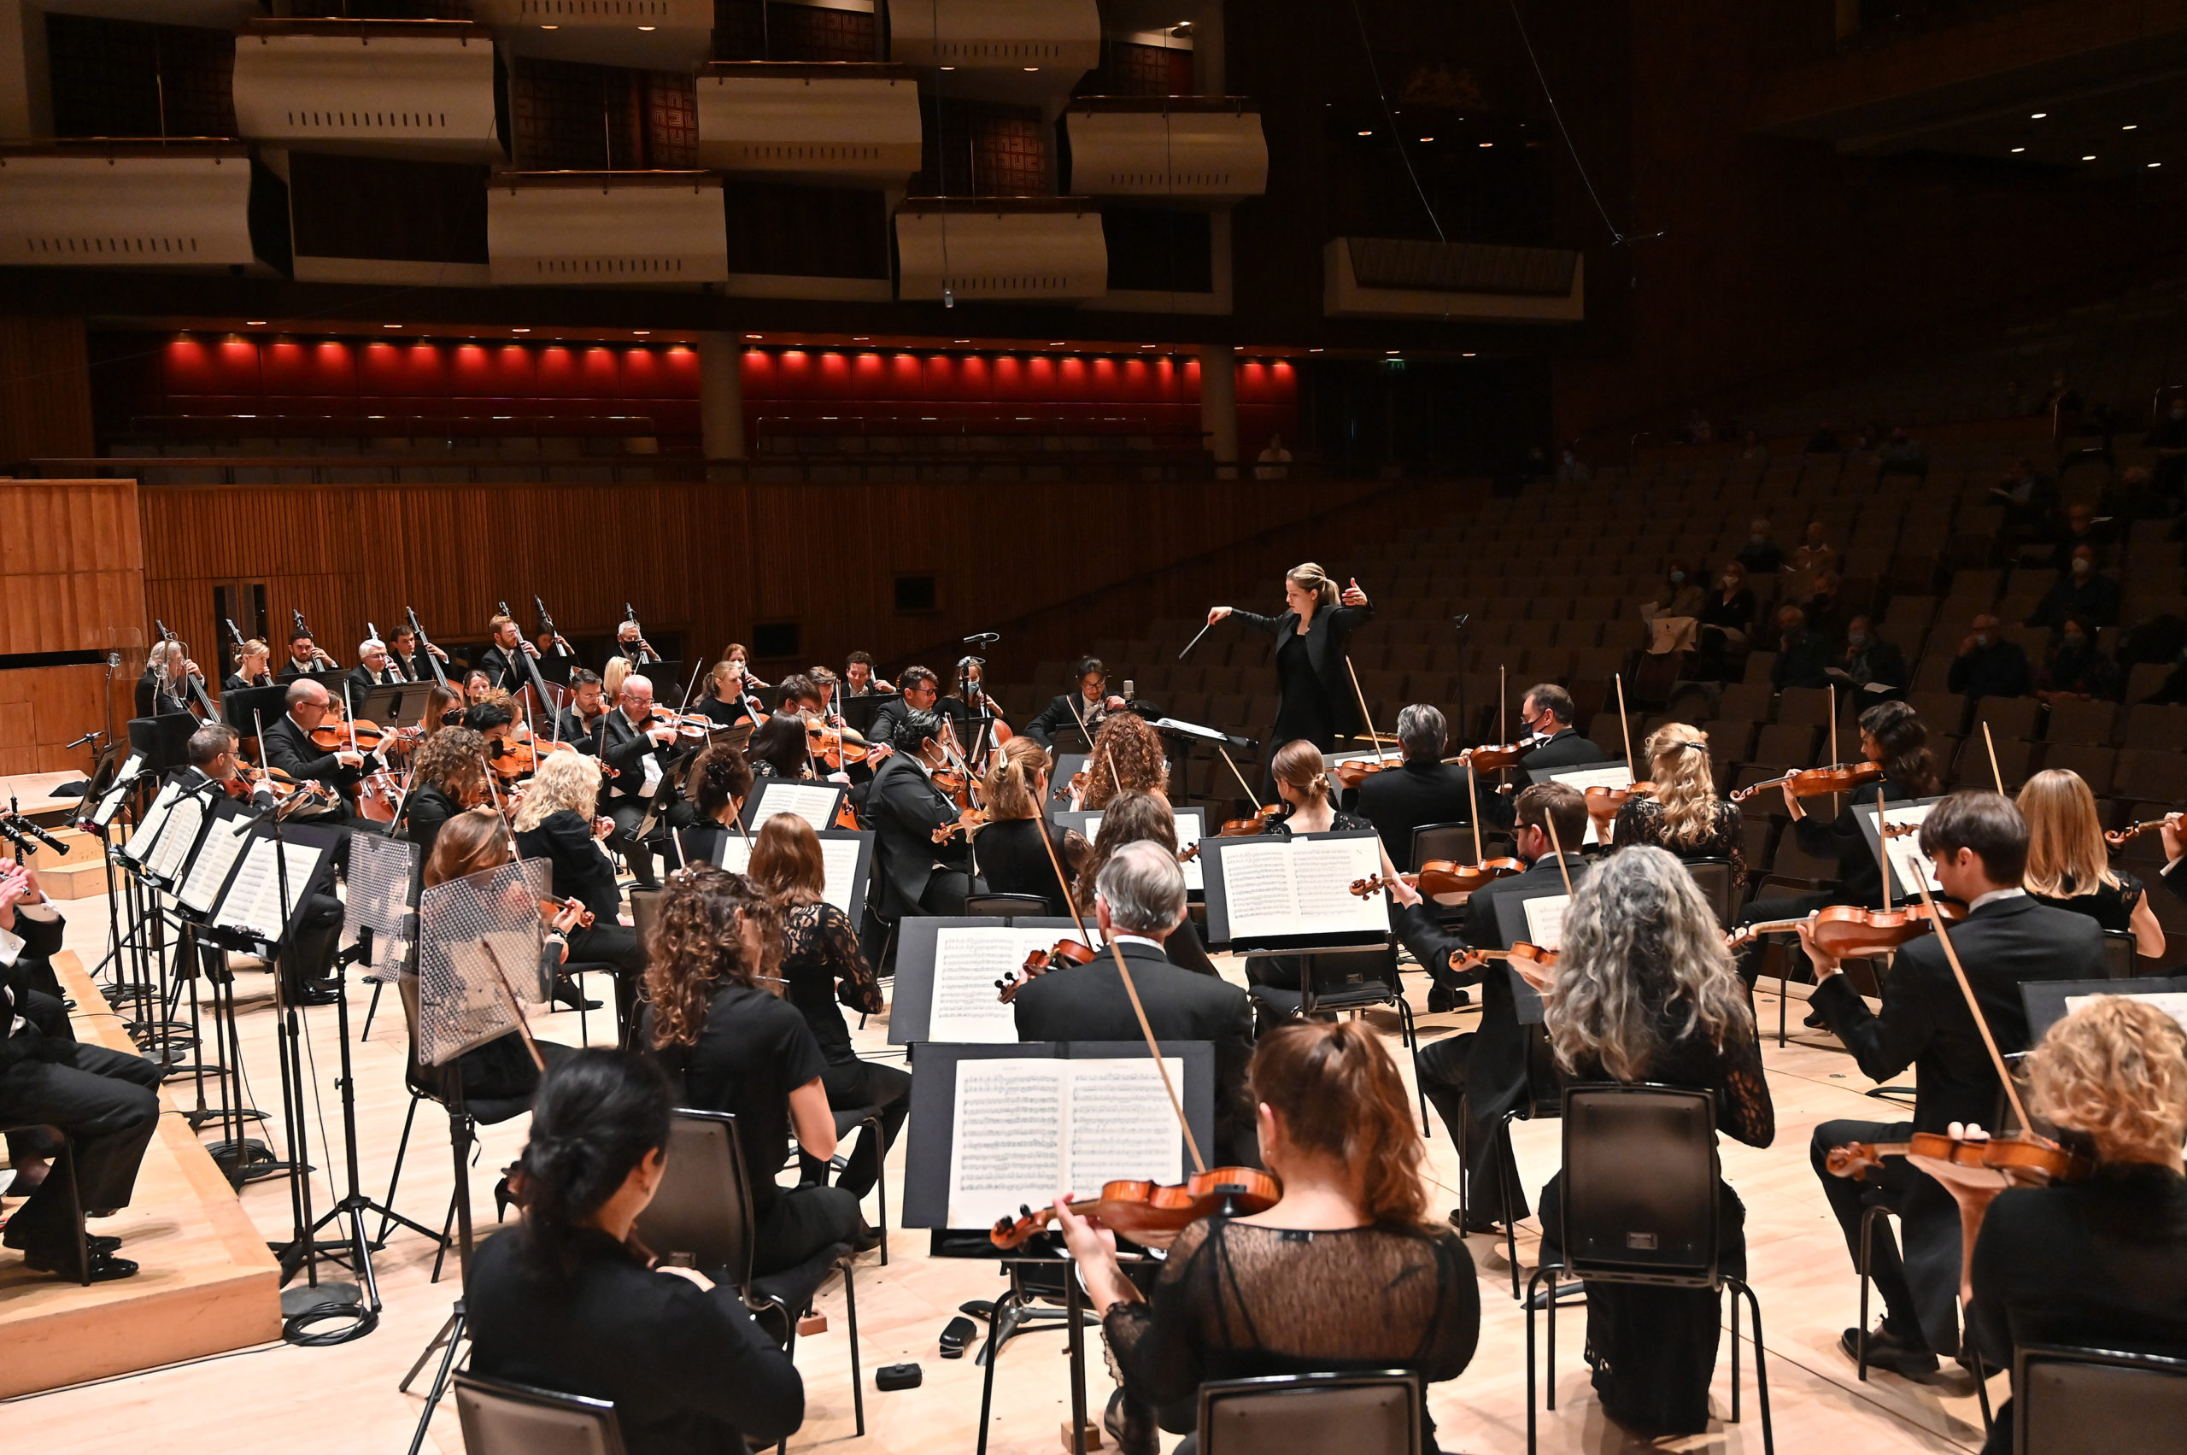
GCSE BrightSparks
Resources
BrightSparks is generously funded by the Rothschild Foundation with additional support from the Candide Trust, Dunard Fund, Rivers Foundation, The R K Charitable Trust, Mr & Mrs Philip Kan, Gill and Julian Simmonds
© Rachel Leach and the London Philharmonic Orchestra 2022

Slide 2
John Williams
(b. 1932)
Star Wars Main
Theme
(1977)

Slide 3
John Williams
(b. 1932)
American film composer
Famous for symphonic scores with leitmotifs
Leitmotif = small music idea that represents a place, character, emotion, theme etc within the film’s story

Slide 4
Williams – Star Wars Main Theme – 1977
Analysis
* Bar numbers taken from Edexcel GCSE anthology

Slide 5
Williams – Star Wars Main Theme – 1977
Introduction and Fanfare (bars 1-4)
Main theme begins with a ‘burst’ of fanfare from the brass section – features classic fanfare figures: arpeggios, repeated staccato notes, tripets, sextuplets
Fast tempo
Bb major
Time signature is 4/4
Quartal harmony = chords based on 4ths

Slide 6
Williams – Star Wars Main Theme – 1977
Luke’s Theme (A) (bars 4-11)
March-like – associated with heroism, adventure
Brass accompanied by syncopated chords from lower strings and inverted tonic pedal from violins
Homophonic

Slide 7
Williams – Star Wars Main Theme – 1977
Luke’s Theme (A) (bars 4-11)
Melody features a distinctive leap of a 5th from tonic to dominant
Later that interval is inverted to become a falling 4th, still tonic to dominant
Theme made up of two balanced 4-bar phrases

Slide 8
Williams – Star Wars Main Theme – 1977
Theme B (bars 11-21)
Played by strings, doubled so stretched across 3 octaves
Accents from glockenspiel
Begins with anacrusis
Mostly conjunct but features a leap of a 6th
Made up of two balanced, 4-bar phrases

Slide 9
Williams – Star Wars Main Theme – 1977
Theme B (bars 11-21)
Second phrase ends with Bb minor scale to the dominant
Contrary motion – downwards and upwards at the same time

Slide 10
Williams – Star Wars Main Theme – 1977
Structure (bars 1-30)
Intro
A A
B B
A A

Slide 11
Williams – Star Wars Main Theme – 1977
Structure (bars 30-end)
Short transition section
Fanfare figures
Sequences for violins
Unstable harmony
Then…
Images on screen dictate musical material

Slide 12
Williams – Star Wars Main Theme – 1977
Stars and Sky Theme (bars 33-39)
Lighter texture at bar 33
Lonely piccolo solo
High strings, celeste, vibraphone and harp reflect the sky, stars and planets on the screen

Slide 13
Williams – Star Wars Main Theme – 1977
Death Star Motif (bars 39-44)
Scurrying strings and block chords from the trombones take us to the next section
Ominous, pounding tonic pedal (C)
Short, menacing brass fanfare with dissonant chords
Death star on screen

Slide 14
Williams – Star Wars Main Theme – 1977
Suspense (bars 44-51)
Time signature changes to 3/4 at bar 44
Tonic pedal
Atonal cluster chords
Homorhythmic = all players play the same rhythm at the same time

Slide 15
Williams – Star Wars Main Theme – 1977
Battle (bars 51-end)
C pedal continues
Brass triads (similar to bar 42)

Slide 16
For more information about concerts, education projects, resources and recordings, visit
lpo.org.uk
BrightSparks is generously funded by the Rothschild Foundation with additional support from the Candide Trust, Dunard Fund, Rivers Foundation, The R K Charitable Trust, Mr & Mrs Philip Kan, Gill and Julian Simmonds
© Rachel Leach and the London Philharmonic Orchestra 2022

